Slide 1
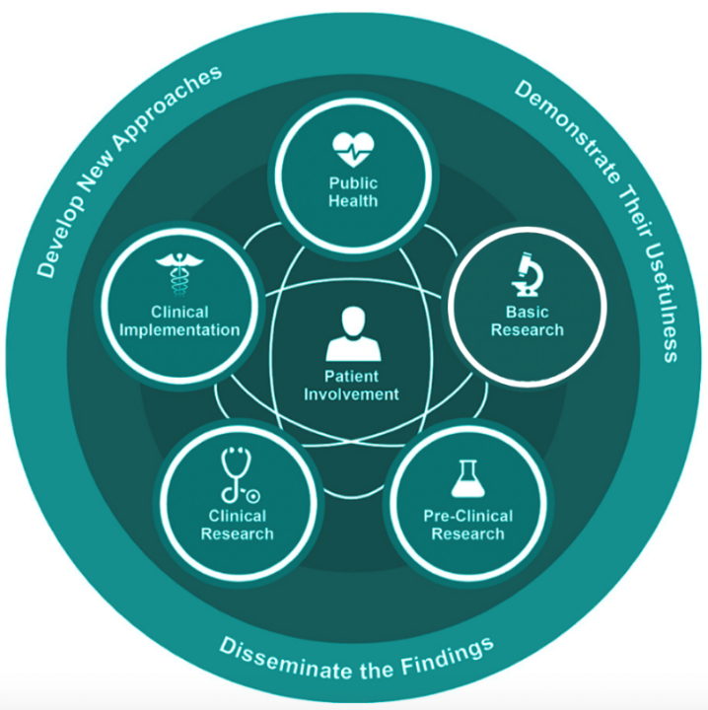
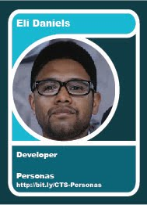
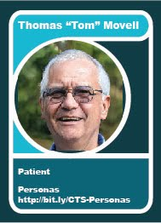
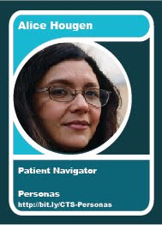
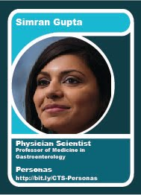
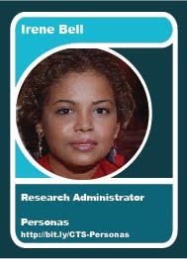


Meet the Personas!
A CD2H Webinar
November 13, 2019
Sara Gonzales, MLIS
Northwestern University
Download the profiles at:
data2health.github.io/CTS-Personas/pages/profiles/
This project is funded by the CTSA National Center for Data to Health (CD2H) and supported by the NIH National Center for Advancing Translational Sciences, grant number U24TR002306, to help guide the cultural and technological changes necessary for data and informatics to improve research and health care.

Slide 2
Today’s agenda
We’ll examine the goals, methods, and deliverables of the CTS-Personas project, including:
The project team and our goals
Choosing the elements of an effective Persona profile
Identifying translational roles to profile
Researching the roles
Design elements of the final profile documents
Final deliverables: CTS-Personas GitHub.io site tour

Slide 3
Understanding the Translational workforce
Understanding the needs and motivators of the translational workforce is essential for:
Developing resources for education and career development
Supporting evaluation and continuous improvement
Fostering good team science
Cultivating meaningful partnerships across translation

Slide 4



Personas: The concept of the translational workforce is an important one and plays a prominent role in the work and communication of CTSA Program hubs, NCATS, and beyond. However, to date, a defined list of translational workforce roles in CTS does not exist. Here, we aim to better define the specific roles included in the translational workforce, establish a set of personas to reflect those roles, construct a portfolio of these persona profiles, and disseminate broadly to the CTSA program and to the CD2H for use in development of use cases, communications, training materials, and more.
6 Jan 2019
Workgroup Name
Workgroup Name
CD2H SHow and Tell, Date
Notes:
Melissa

Slide 5
CTS-Personas: The Team and our Mission
Project kickoff: January 2019
 | Children’s Hospital of Philadelphia: Bailey Farrow Allison Heath Meen Chul Kim Deanne Taylor Oregon Health & Science University: Robin Champieux Washington University: Po-Yin Yen
Northwestern University:
Sara Gonzales (Project Lead)
Karen Gutzman
Lisa O’Keefe
Guillaume Viger
Annie Wescott
Kristi Holmes
Goal: Profile one dozen roles across translational science and publish them as accessible, one-page documents. Provide supporting materials such as use cases and a User Guidebook.

Slide 6
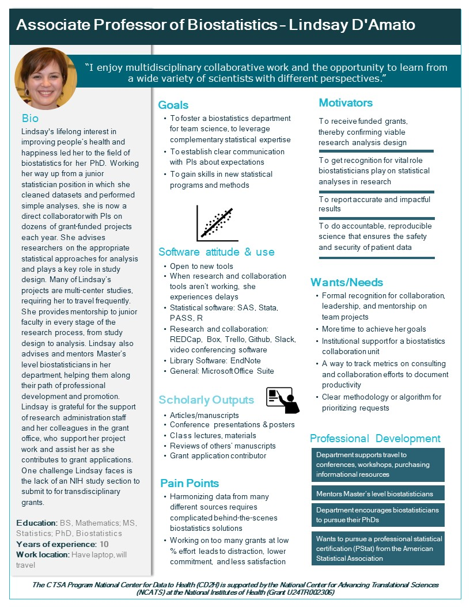
What is a Persona Profile?:
the translational workforce
4
1
2
3
11
10
Name
Photo
Quote
Descriptive Job Title
Major responsibilities
Expertise: training, years on job, etc.
Workplace environment
Software and data use at work
Technology attitude
Motivators
Goals
Wants/Needs
Pain points/Challenges
Scholarly output activities
Continuing Education Goals/Training Opportunities
5
8, 9
12
14
15
13
6, 7
Notes:
-Elements that make it personal: Name, photo, quote
-Bio and job duties in order to understand the basics of the person’s role. Educational level, years of experience, and where they work is also vital.
-Detailed sections on Goals, Needs, Motivators, Pain points, Software attitude and use, and Professional Development needs
-The challenge was how best to amass this information, review and distill it for a dozen profiles in only 6 months?

Slide 7



Creating the CTS-Personas: Methodology
Step 1: elements of an effective Persona
Notes:
-First the team consulted sources on creating personas. All the sites mentioned here, and many more, particularly from the realm of for-profit software user experience design, contained recommendations about elements to include in a well-rounded persona. We took the elements from each and mapped them to each other, noting which elements were most commonly used. We discussed which elements would be the most useful in a biomedical context. In the end we came up with the finished elements you can see in the Persona profiles

Slide 8
Creating the CTS-Personas: Methodology
Step 2: Identifying one dozen roles to profile in CTS
Examine CTSA Organizational Charts and Job Descriptions
Employ text analysis to identify term clusters in CTS
Choose 1-2 jobs per cluster
Vote on 12 roles to profile, plus two patients
.a
.b
.c
.d
79 unique positions identified
NLP identified common terms in job descriptions: development, project, data, study, team, system, clinical, care, patient, education
Used the common terms to cull the list down to 79 positions.
Personas team voted on final dozen roles to profile. Two patient roles added.
Notes:
-

Slide 9
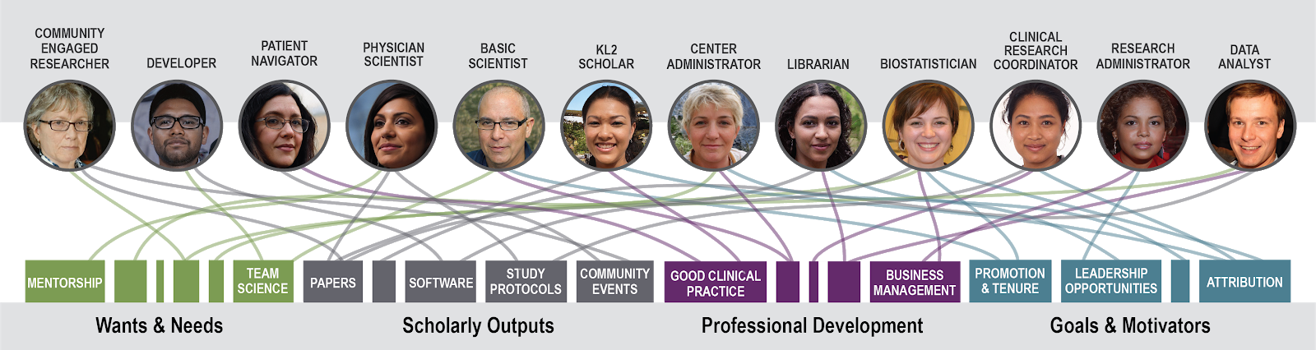
Creating the CTS-Personas: Methodology
Roles across clinical and translational science
Basic Scientist
Biostatistician
Clinical Research Center Administrator
Clinical Research Coordinator
Community-Engaged Researcher
Data Analyst
Developer
K Scholar
Librarian
Patient Navigator
Physician Scientist
Research Administrator

Slide 10
Creating the CTS-Personas: Methodology
Step 3: Researching the roles
Writing interview questions
Data amalgamation and analysis; writing the profiles
Literature Review
Conducting interviews
.a
.b
.c
.d
Published sources saved in Google Drive: https://drive.google.com/drive/folders/1QRVwKfvjDNizvMrvWLkD-BHr2UMIeWzF?usp=sharing
Interview questions derived from the profile elements. Sources like EBI and Usability.gov helpful.
Interviews: a major part of the Persona creation process. Allow time for:
IRB application
The interviews themselves (ideally 3 per role)
Transcription
De-identification
Data analysis
Match the literature and interview data to the profile elements

Slide 11
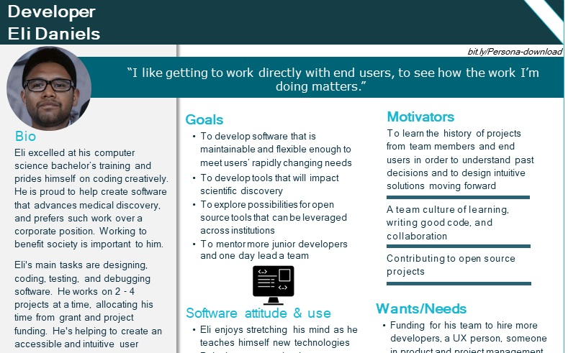
A robust Persona profile, designed from the ground up
Notes:
-Writing the profiles is more than just writing. Allow time and find the expertise for creating the layout and design of your profiles. Find one template you can use over and over. If you want to add to the CTS-Personas project, please feel free to use one of ours as your template.
-Allow time for multiple reviews and revisions.
-Don’t use images of real people, if at all possible. Use stock photos or something like our team used, a website that generates AI images
-Don’t use names that could be confused with a well-known person or celebrity

Slide 12
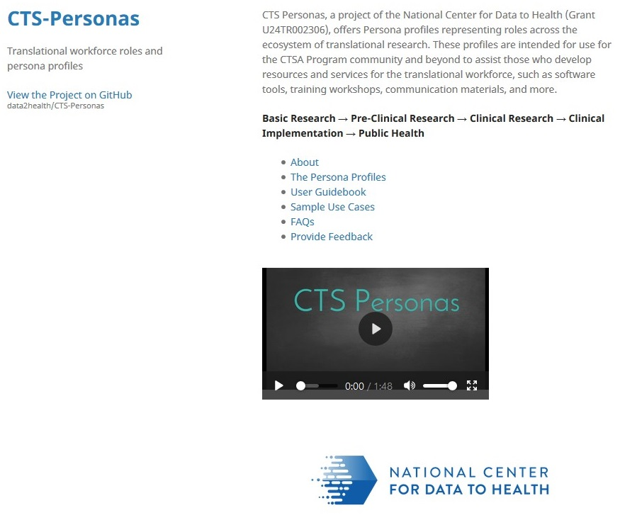
Project Deliverables – Tour the CTS-Personas website
https://data2health.github.io/CTS-Personas/

Slide 13
Questions?
CTS-Personas on GitHub
Main site: https://github.com/data2health/CTS-Personas
GitHub IO site: https://data2health.github.io/CTS-Personas/
CD2H Website
https://ctsa.ncats.nih.gov/cd2h/

